Slide 1
More on image features
Prof. Biplab Banerjee

Slide 2
Plan
HOG
Interest points
Corners
SIFT
Bag of words encoding
First step towards deep learning - GIST

Slide 3
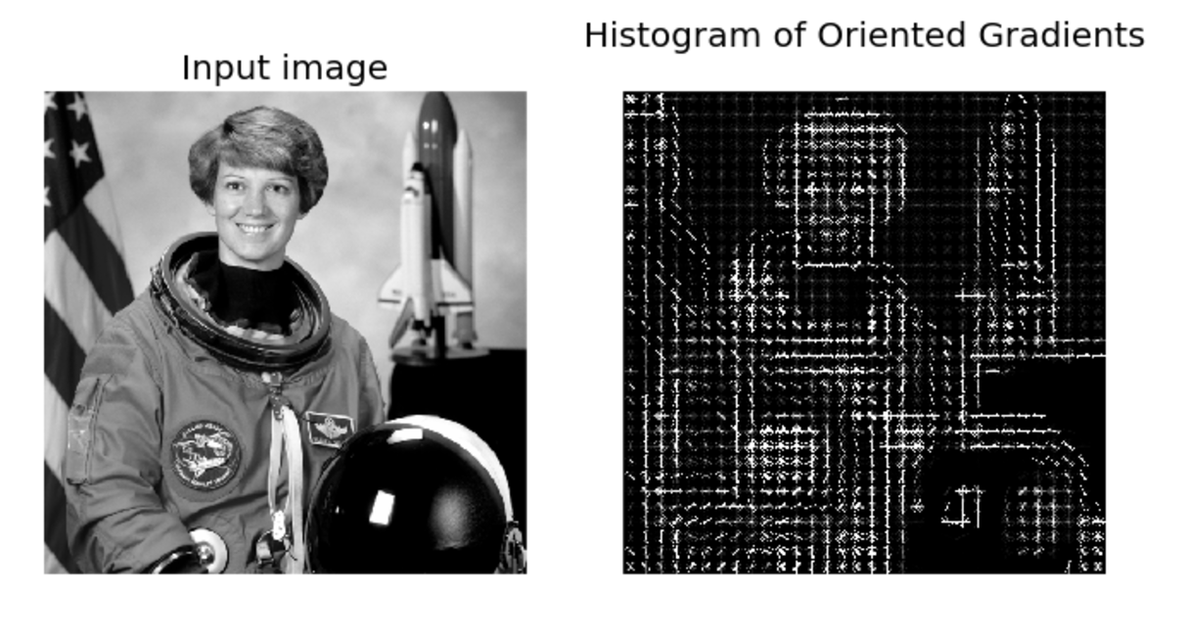
Image Features: HoG
Paper by Navneet Dalal & Bill Triggs presented at CVPR 2005 for detecting people.

Slide 4
Image Features: HoG

Slide 5
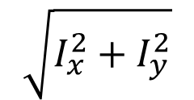
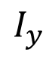
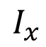
Image Features: HoG
Compute gradients
$$\sqrt{I_{x}^{2}+I_{y}^{2}}$$
$$I_{x}$$
$$I_{y}$$
*

Slide 6
Image Features: HoG
We will aggregate
gradient magnitude
and directions
in 8x8 pixel regions

Slide 7
Image Features: HoG
Compute a histogram
with 9 bins for angles from 0 to 180

Slide 8
Image Features: HoG
Normalize histograms with respect to histograms of adjacent neighbors.

Slide 9
Image Features: HoG
Image (or image region) represented by a vector containing all the histograms.
In this case how long is that vector?

Slide 10
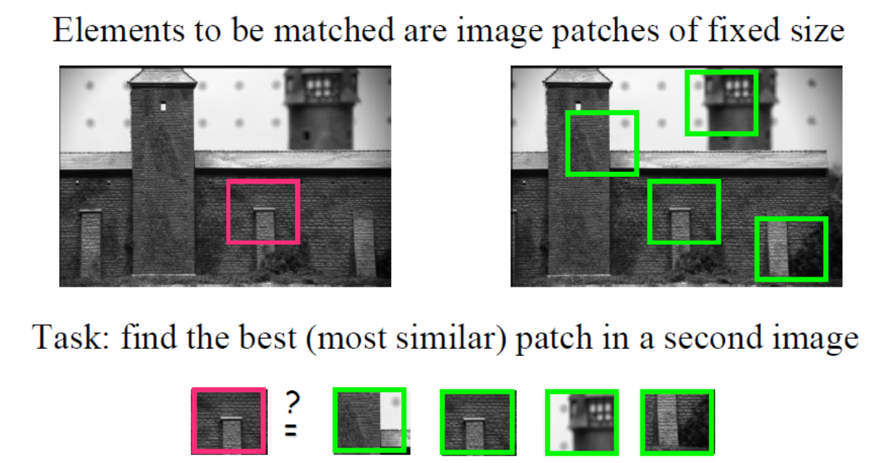
Interest points - motivation

Slide 11
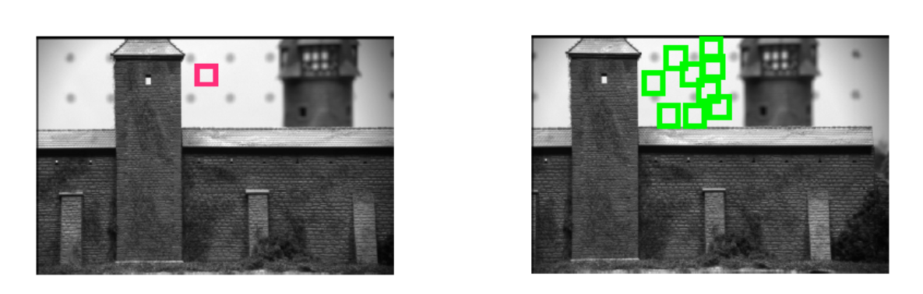

Interest points - motivation

Slide 12
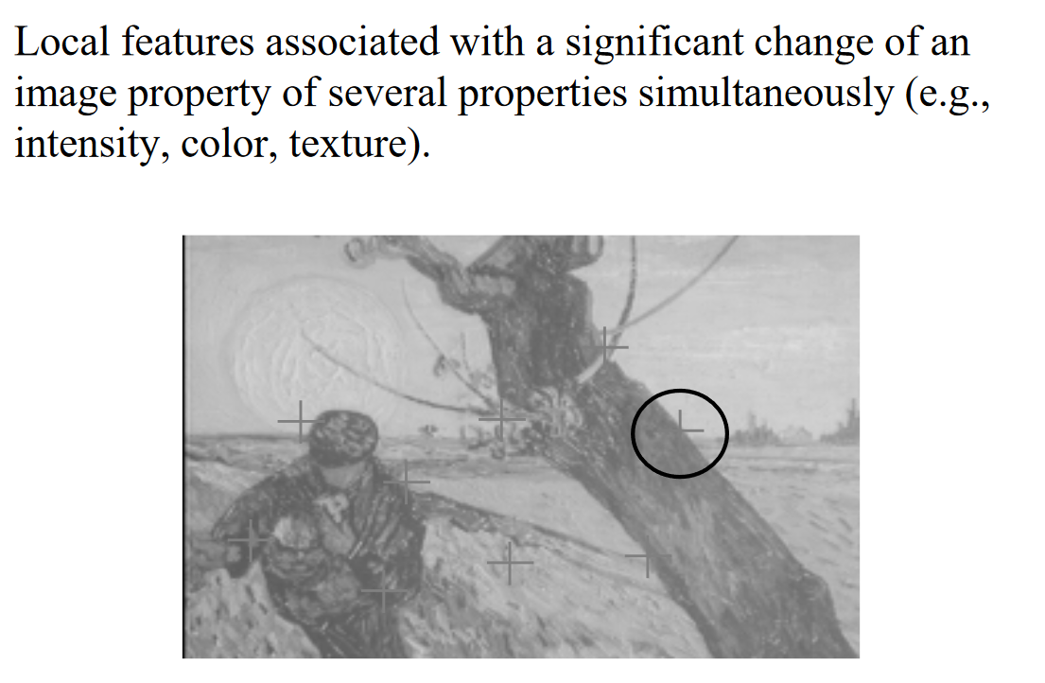

Slide 13
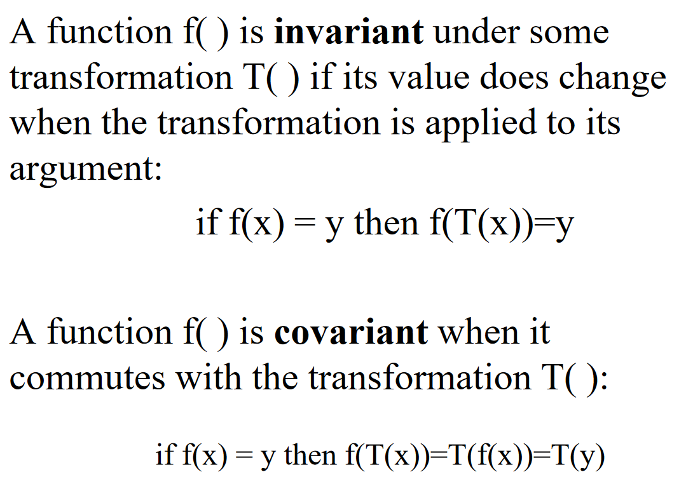
Invariant and covariant

Slide 14
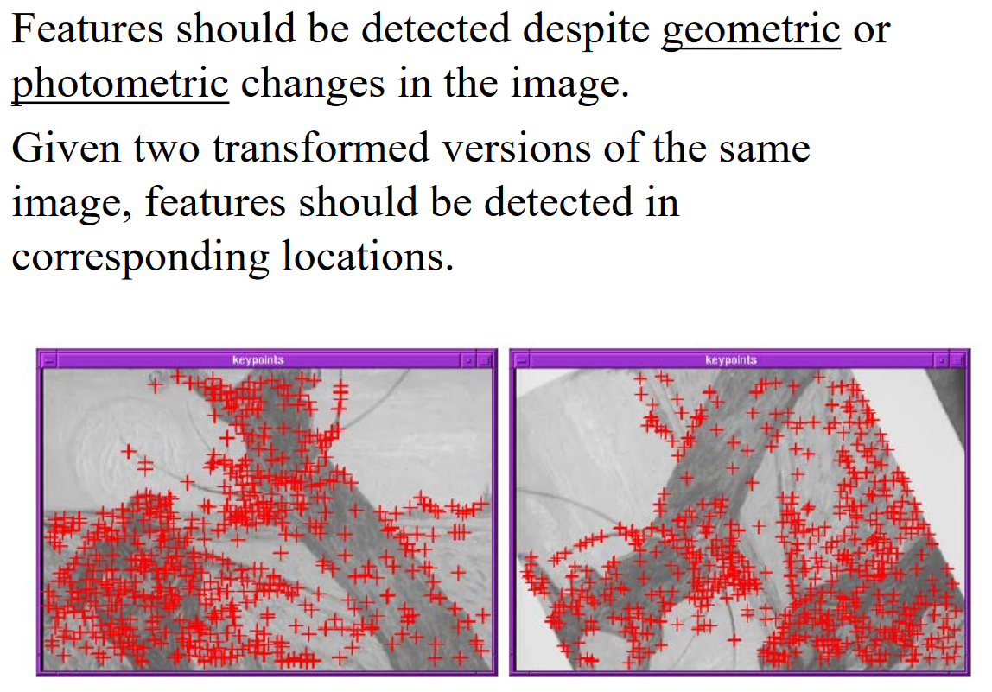

Slide 15
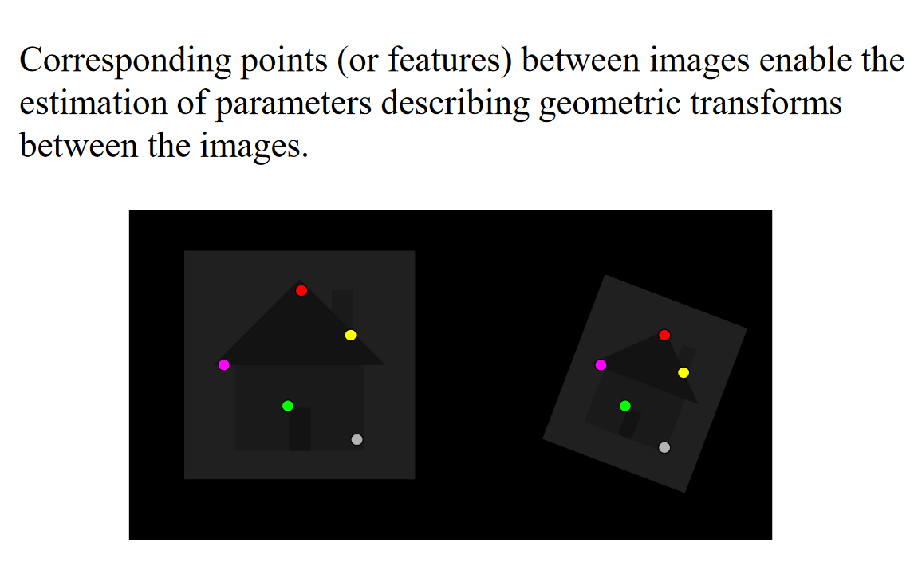

Slide 16
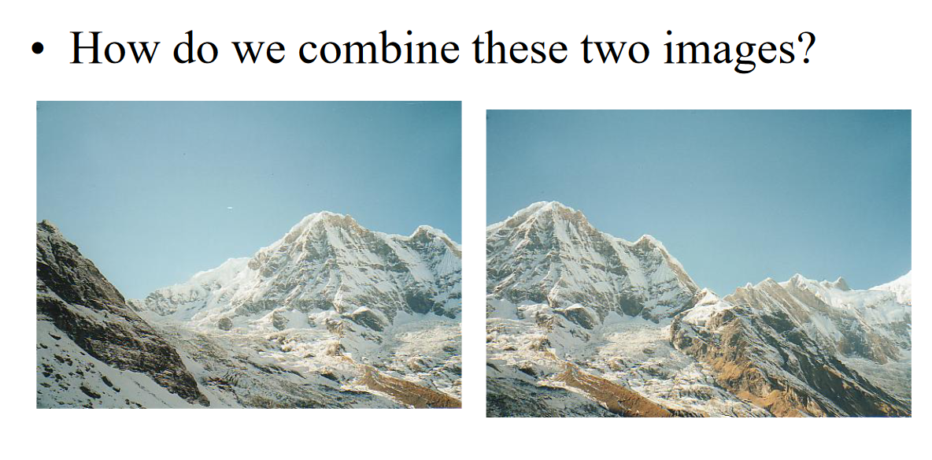

Slide 17
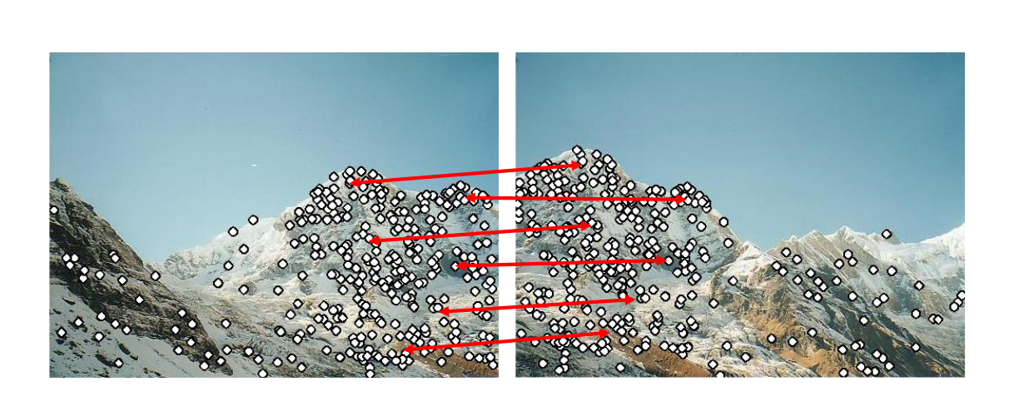
Panorama stitching

Slide 18
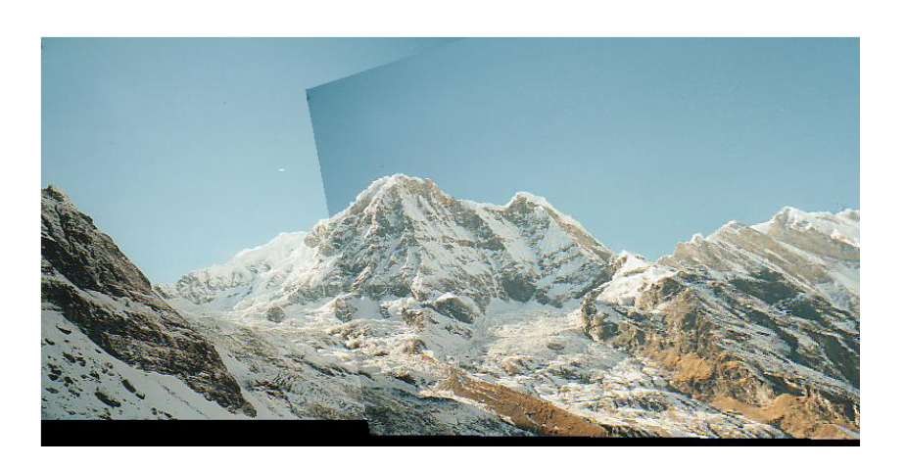

Slide 19
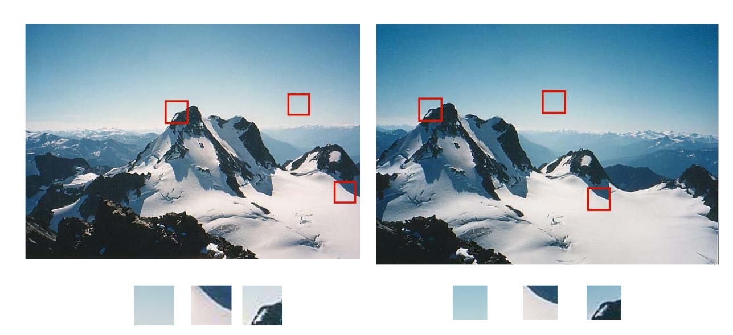
Corners

Slide 20
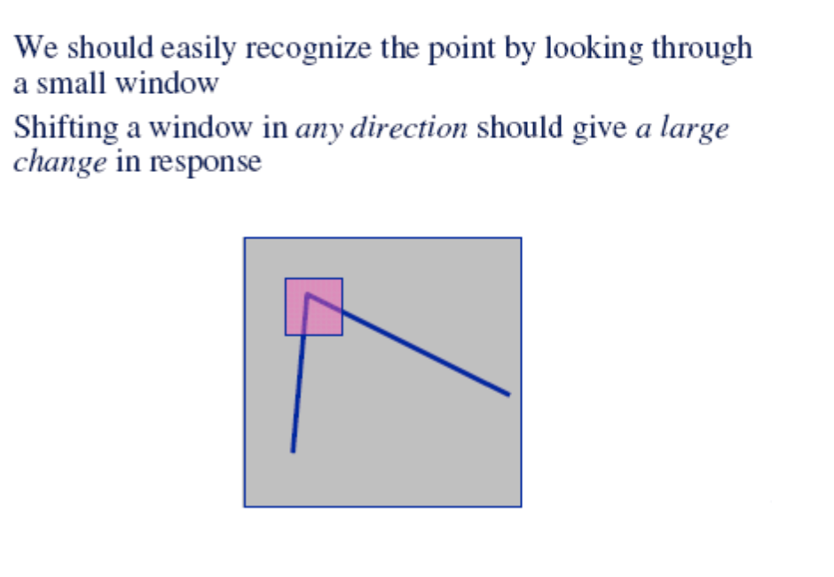

Slide 21
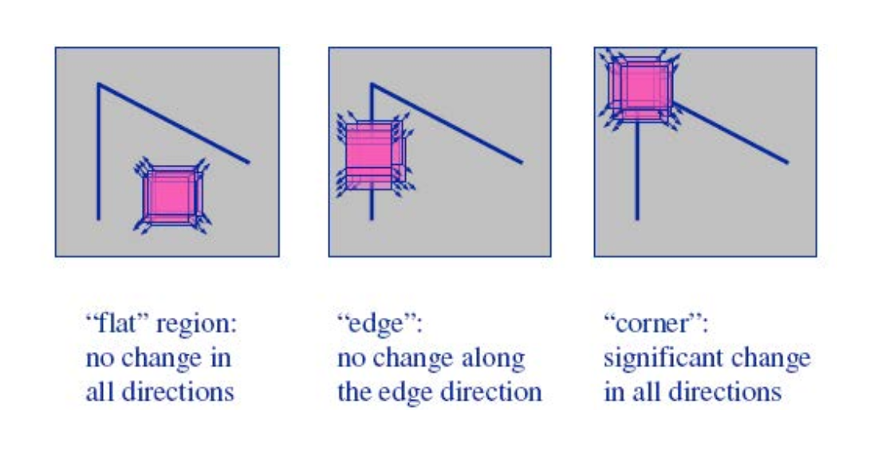

Slide 22
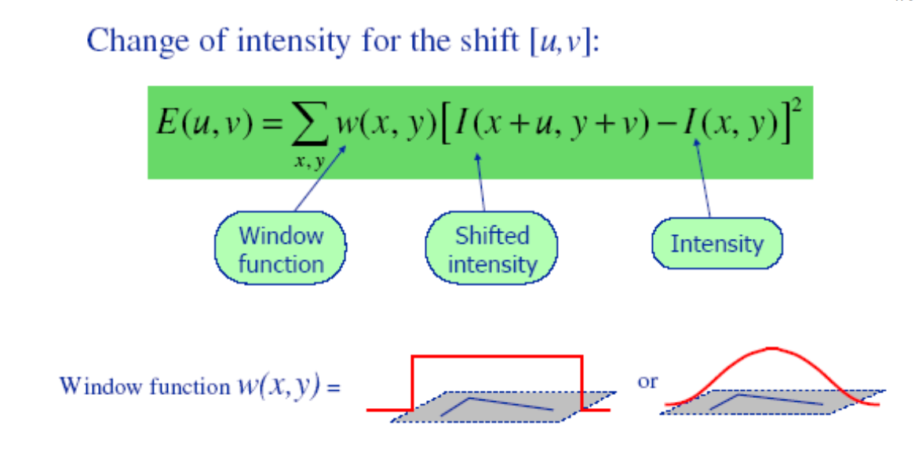

Slide 23
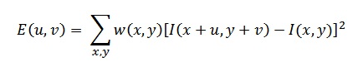
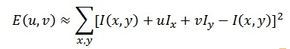
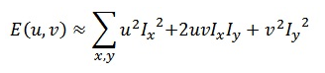
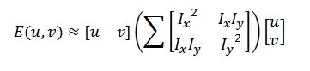
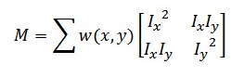
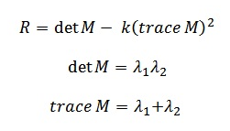
Cornerness

Slide 24
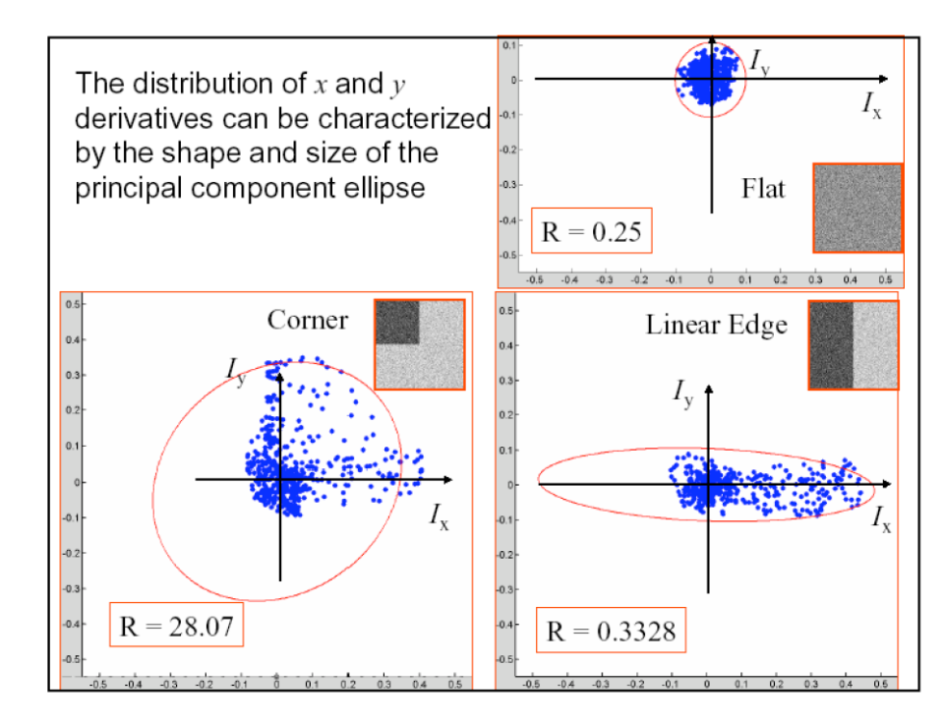

Slide 25
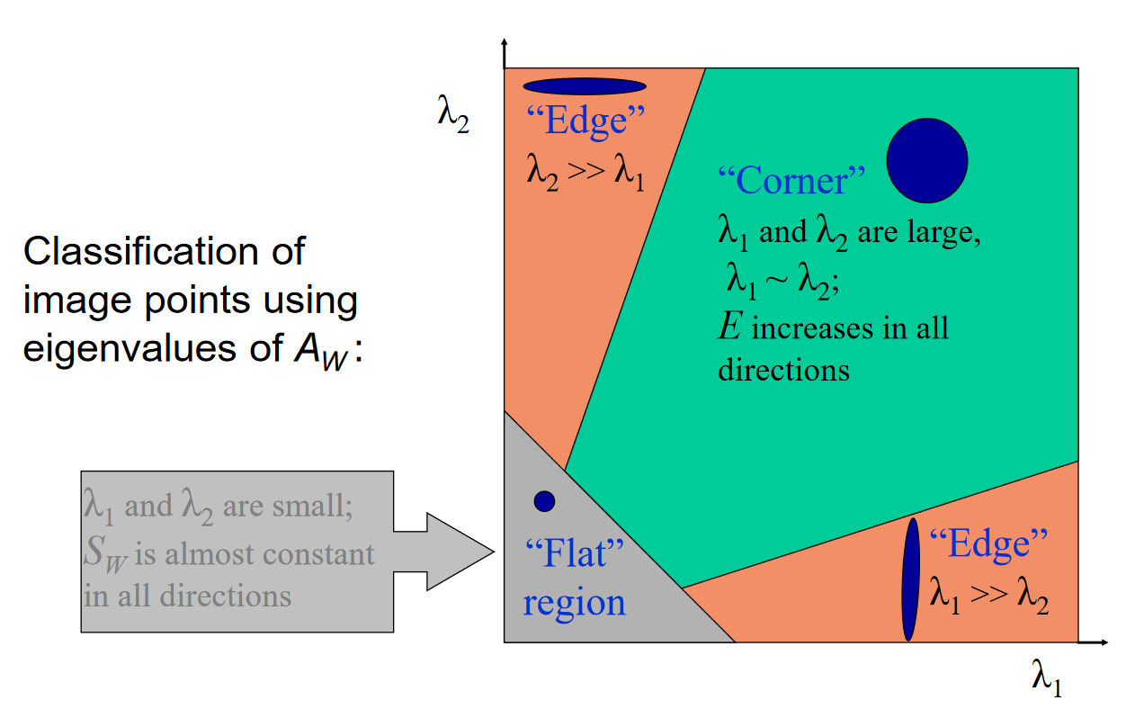

Slide 26
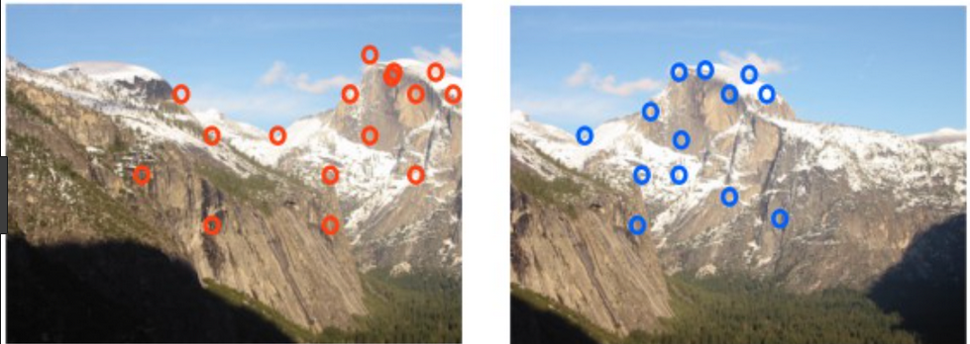
Scale Invariant Feature Transform (SIFT)

Slide 27
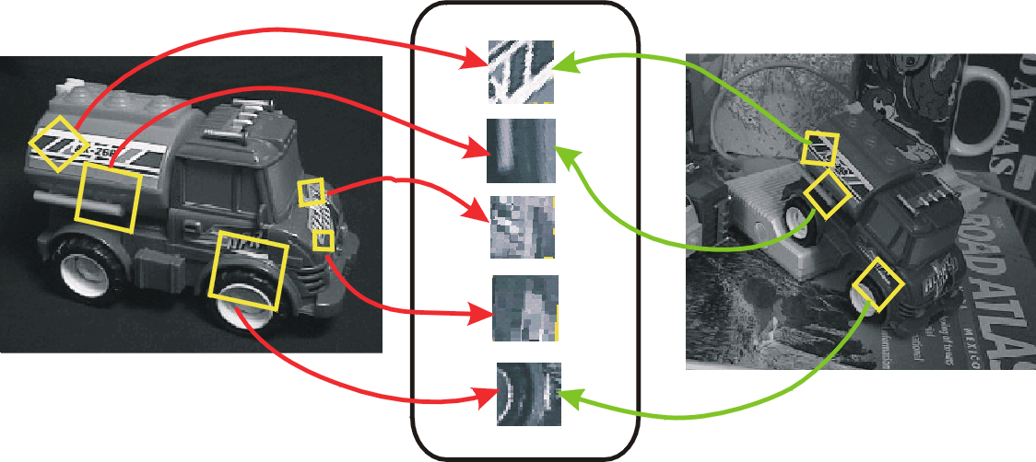
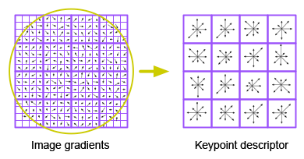
SIFT Keypoint descriptors: Used for Matching
Compare SIFT feature vectors
Figure by Svetlana Lazebnik
Notes:
From the paper:
The previous operations have assigned an image location, scale, and orientation to each keypoint. These parameters impose a repeatable local 2D coordinate system in which to describe the local image region, and therefore provide invariance to these parameters. The next step is to compute a descriptor for the local image region that is highly distinctive yet is as invariant as possible to remaining variations, such as change in illumination or 3D viewpoint. One obvious approach would be to sample the local image intensities around the keypoint at the appropriate scale, and to match these using a normalized correlation measure. However, simple correlation of image patches is highly sensitive to changes that cause misregistration of samples, such as affine or 3D viewpoint change or non-rigid deformations. A better approach has been demonstrated by Edelman, Intrator, and Poggio (1997). Their proposed representation was based upon a model of biological vision, in particular of complex neurons in primary visual cortex. These complex neurons respond to a gradient at a particular orientation and spatial frequency, but the location of the gradient on the retina is allowed to shift over a small receptive field rather than being precisely localized. Edelman et al. hypothesized that the function of these complex neurons was to allow for matching and recognition of 3D objects from a range of viewpoints. They have performed detailed experiments using 3D computer models of object and animal shapes which show that matching gradients while allowing for shifts in their position results in much better classification under 3D rotation. For example, recognition accuracy for 3D objects rotated in depth by 20 degrees increased from 35% for correlation of gradients to 94% using the complex cell model. Our implementation described below was inspired by this idea, but allows for positional shift using a different computational mechanism.

Slide 28
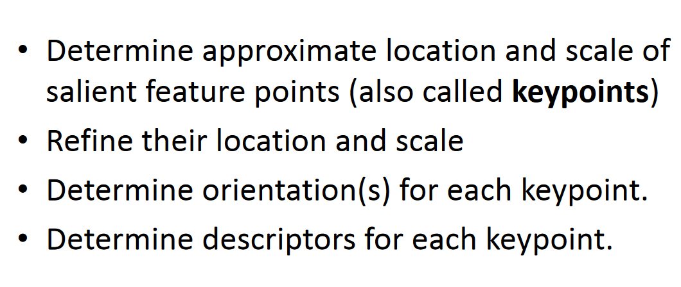
SIFT stages

Slide 29
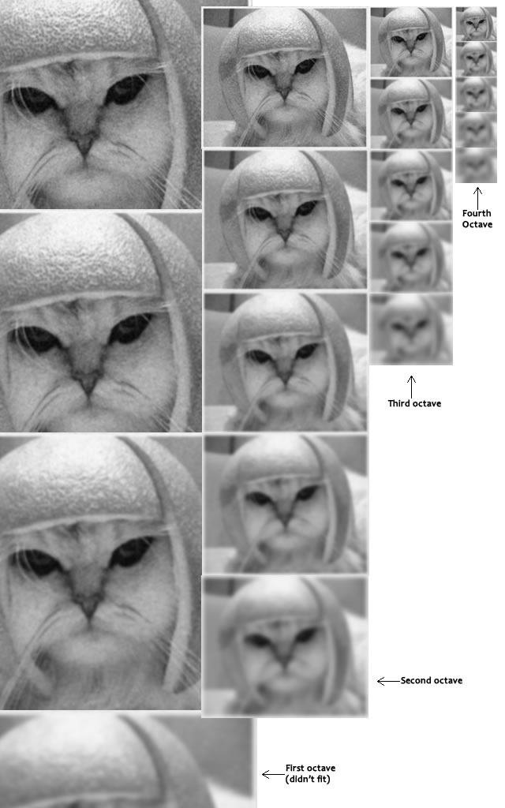
Scale-space generation – step1

Slide 30
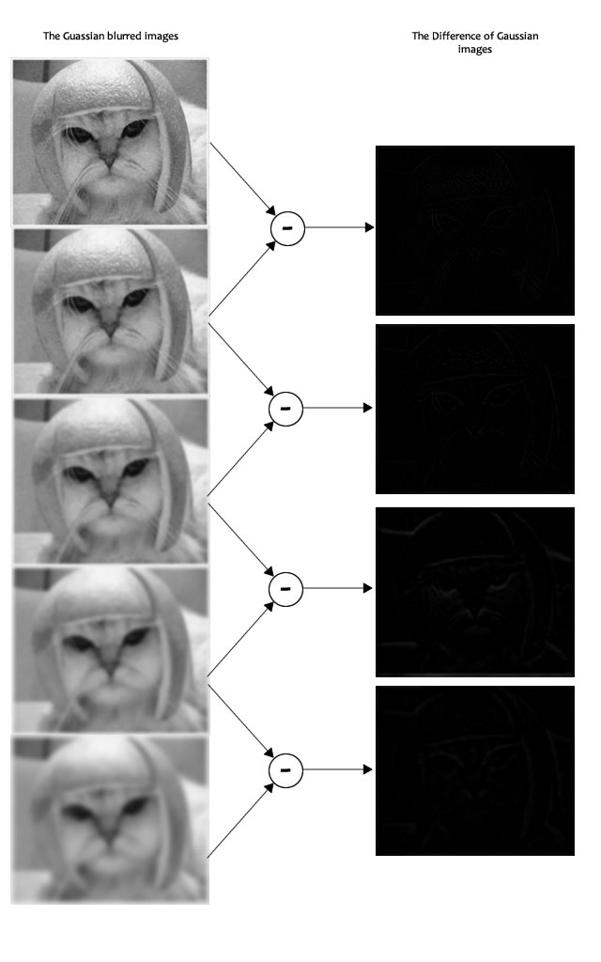
Difference of Gaussian – step2

Slide 31
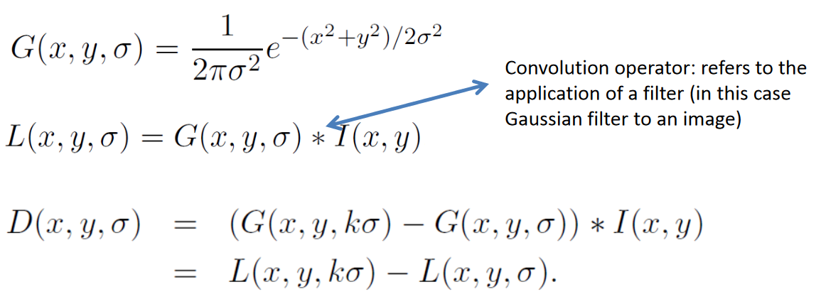

Slide 32
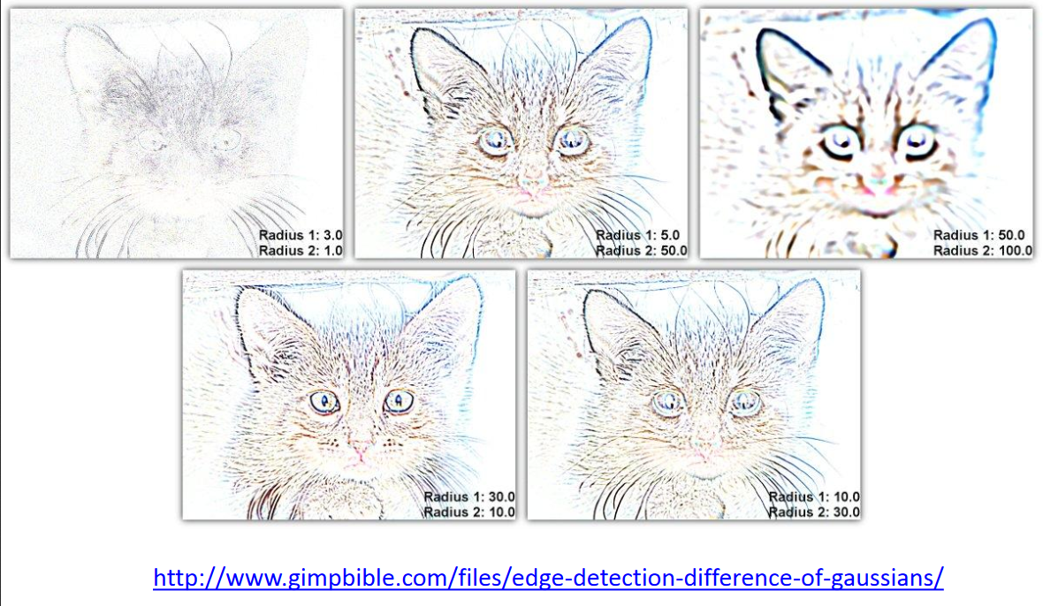

Slide 33
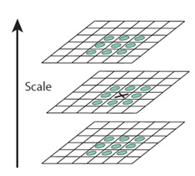
Initial keypoints detection – step3
Remove keypoints if detection
Within low illumination regions

Slide 34
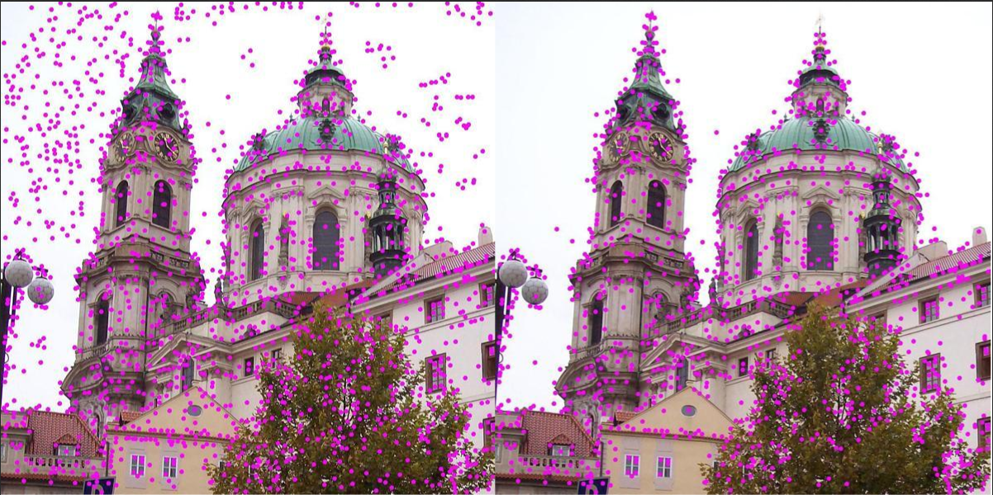

Slide 35
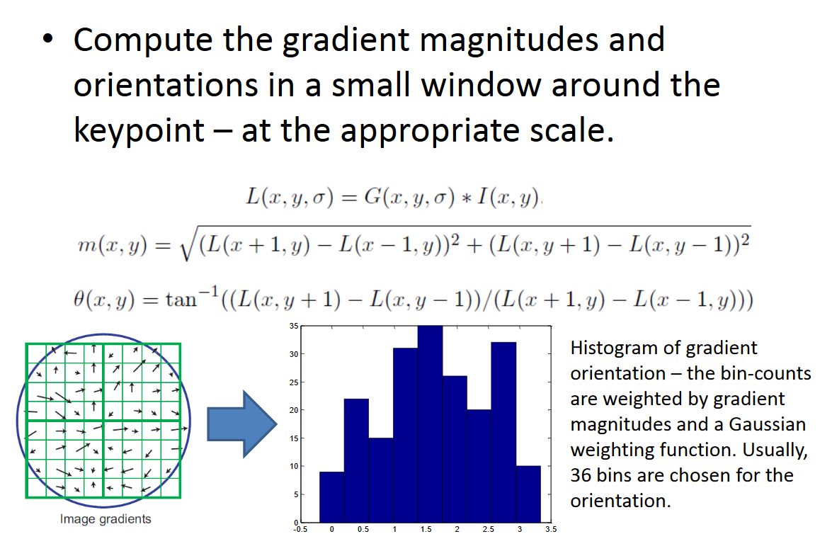
Orientation assignment

Slide 36
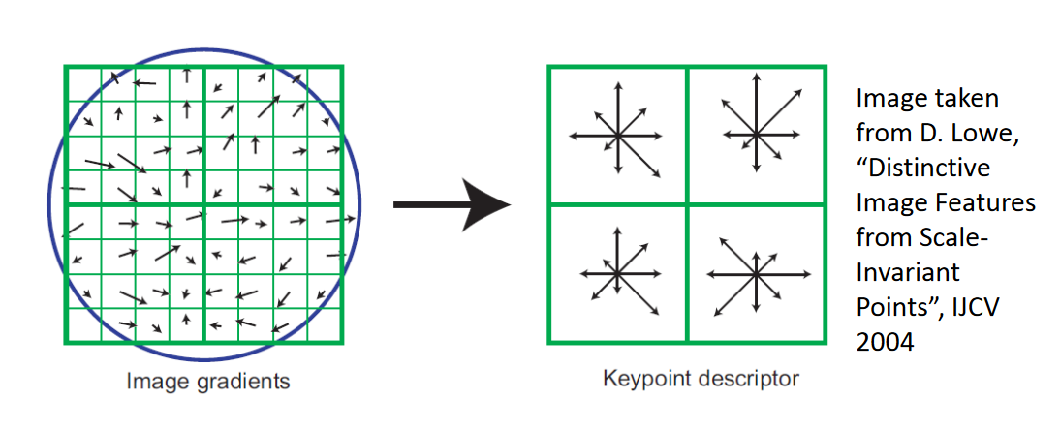
Descriptors

Slide 37
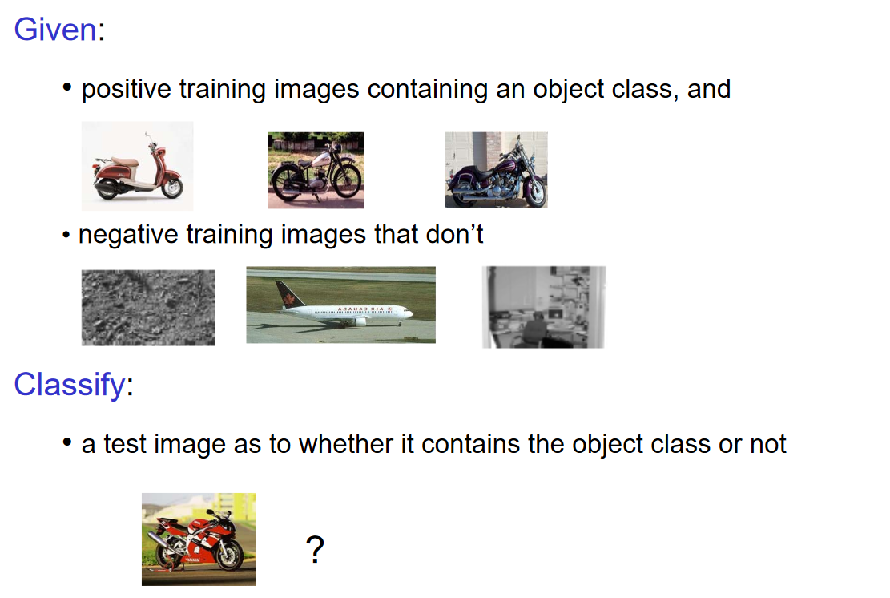

Slide 38
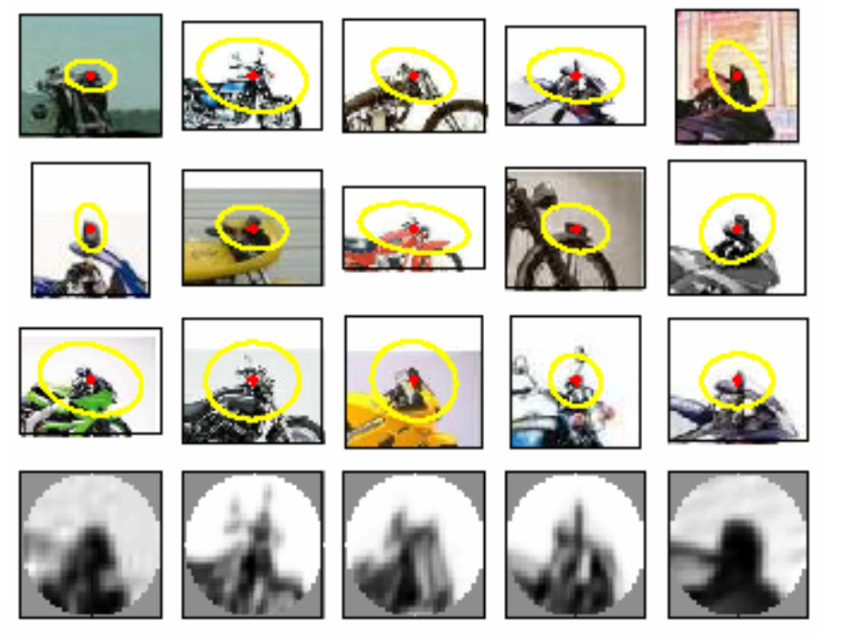
Visual words

Slide 39
Image Features: Bag of (Visual) Words Representation
Bag of Features (read more in Gabriela Csurka’s ECCV 2004 paper)
slide by Fei-fei Li

Slide 40
Extract SIFT Feature Descriptors
slide by Fei-fei Li

Slide 41
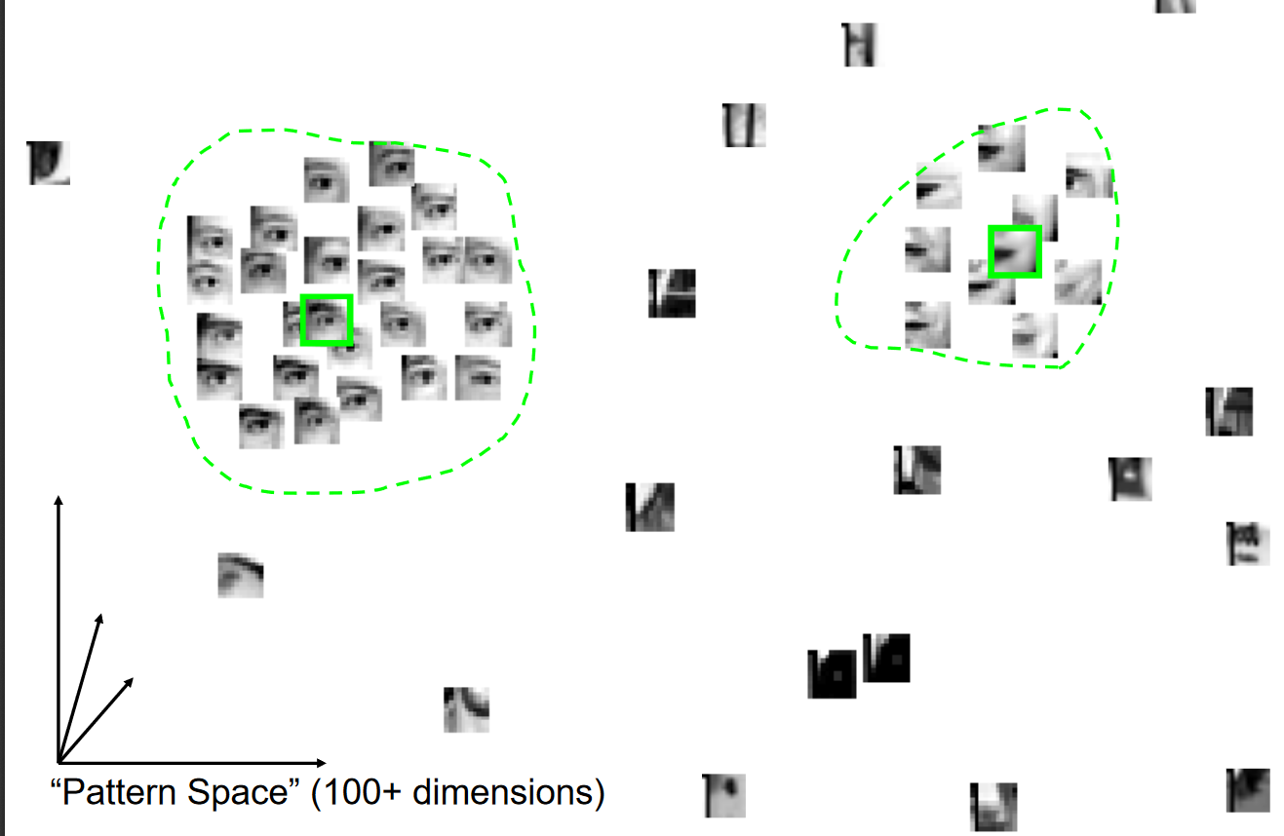

Slide 42
Extract SIFT Feature Descriptors
Create Dictionary of Distinctive SIFT Features
slide by Fei-fei Li

Slide 43
Extract SIFT Feature Descriptors
Compute Histograms of Features
slide by Fei-fei Li

Slide 44
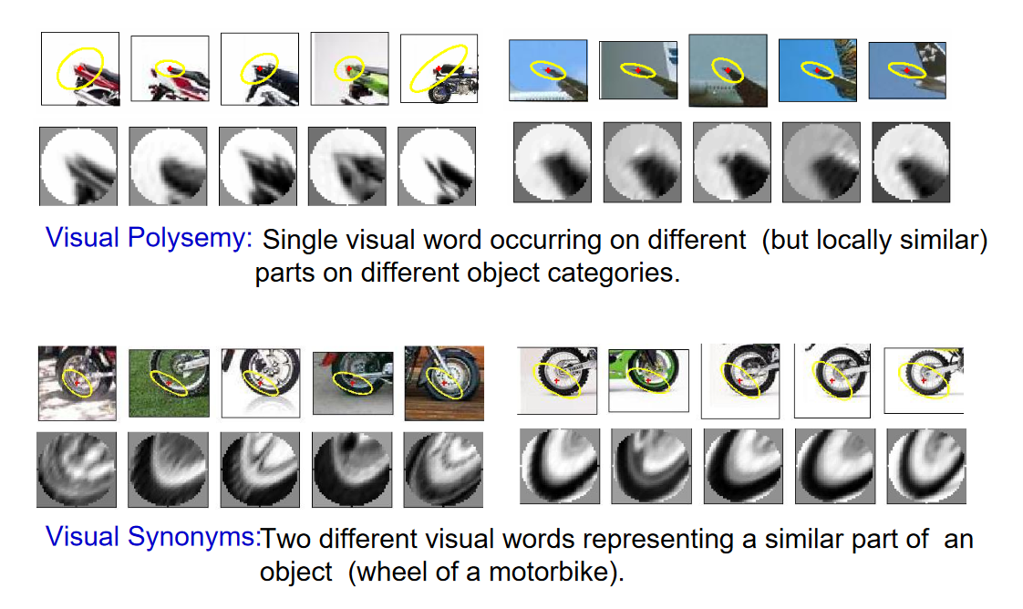

Slide 45
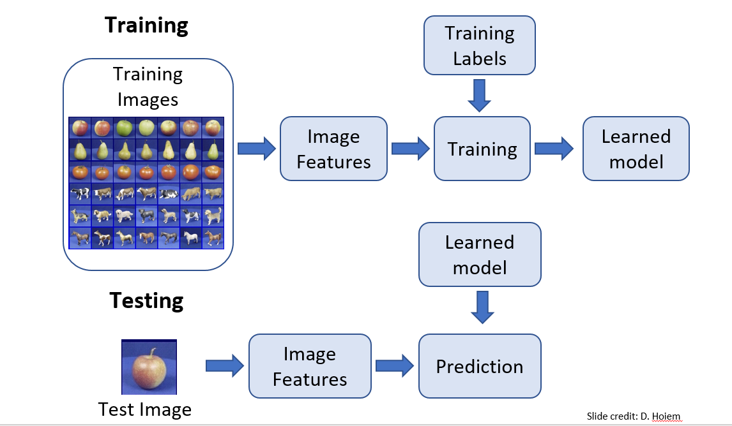

Slide 46
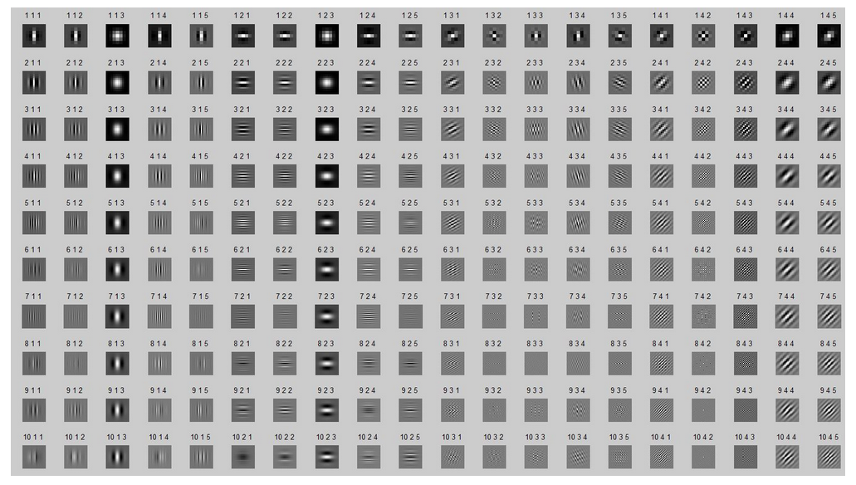

Slide 47
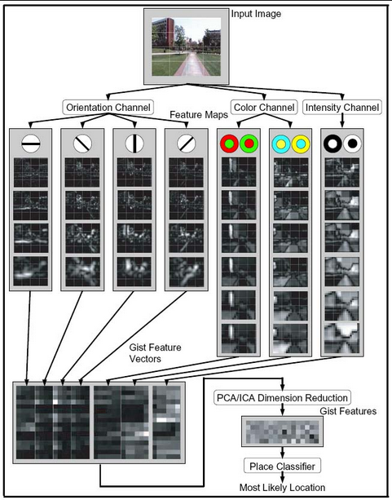
GIST

Slide 48
Idea of low, mid and high level features
Edge, point, line – low level
Visual words – mid level
Object feature – high level (more semantic meanings)
However, we have different set of techniques for extracting such features before deep learning
Those techniques are not optimized
No idea on which feature is good for which data/task
But, this gives the notion of hierarchical features!

Slide 49
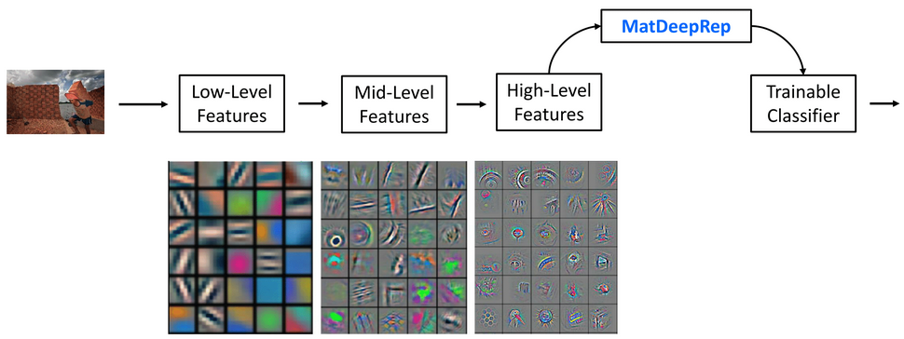
In deep learning

Slide 50
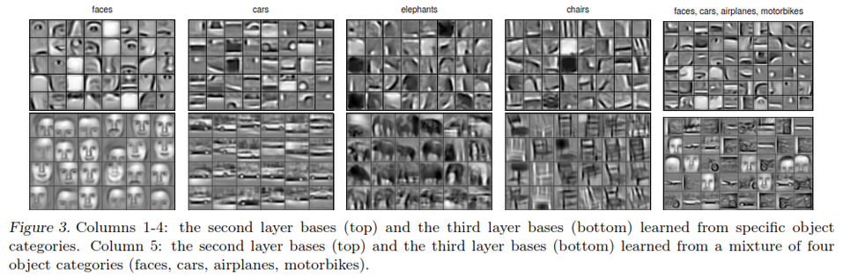

Slide 51
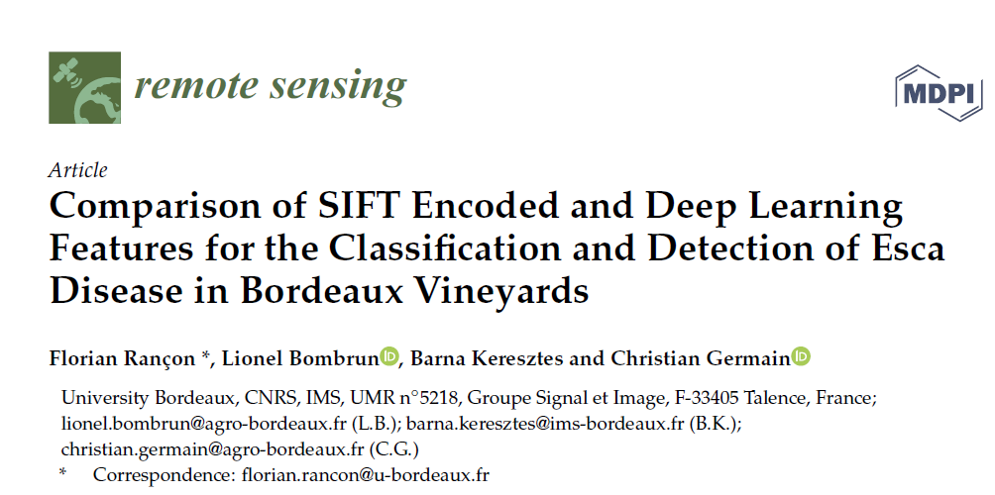
Suggested readings

Slide 52
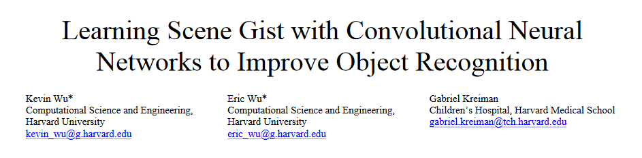
Suggested readings

Slide 53

Suggested readings

